Slide 1


S3 and EBS

Slide 2
Simple Storage Service
Storage for Internet
Designed to make web-scale computing easier for developers
Store and retrieve any amount of data at reliable, fast pace
Notes:
Has a simple web services interface that you can use to store and retrieve any amount of data, at any time, from anywhere on the web. It gives any developer access to the same highly scalable, reliable, fast, inexpensive data storage infrastructure that amazon uses to run its own global network of web sites. The service aims to maximize benefits of scale and to pass those benefits on to the developer.
Amazon Simple Storage Service (Amazon S3) is an object storage service that offers industry-leading scalability, data availability, security, and performance. This means customers of all sizes and industries can use it to store and protect any amount of data for a range of use cases, such as websites, mobile applications, backup and restore, archive, enterprise applications, IoT devices, and big data analytics. Amazon S3 provides easy-to-use management features so you can organize your data and configure finely-tuned access controls to meet your specific business, organizational, and compliance requirements. Amazon S3 is designed for 99.999999999% (11 9's) of durability, and stores data for millions of applications for companies all around the world.

Slide 3
S3 Basics
S3 stores data as objects within buckets. An object consists of a file and optionally any metadata that describes that file.
To store an object in Amazon S3, you upload the file you want to store to a bucket. When you upload a file, you can set permissions on the object as well as any metadata.
Buckets are the containers for objects. You can have one or more buckets. For each bucket, you can control access to it (who can create, delete, and list objects in the bucket), view access logs for it and its objects, and choose the geographical region where Amazon S3 will store the bucket and its contents.

Slide 4
S3 Concepts
Buckets
Objects
Keys
Regions
S3 data consistency model
Notes:
Buckets
A bucket is a container for objects stored in Amazon S3. Every object is contained in a bucket. For example, if the object named photos/puppy.jpg is stored in the johnsmith bucket, then it is addressable using the URL http://johnsmith.s3.amazonaws.com/photos/puppy.jpg.
Buckets serve several purposes:
They organize the Amazon S3 namespace at the highest level.
They identify the account responsible for storage and data transfer charges.
They play a role in access control.
They serve as the unit of aggregation for usage reporting.
You can configure buckets so that they are created in a specific AWS Region. For more information, see Accessing a Bucket. You can also configure a bucket so that every time an object is added to it, Amazon S3 generates a unique version ID and assigns it to the object.
Objects
Objects are the fundamental entities stored in Amazon S3. Objects consist of object data and metadata. The data portion is opaque to Amazon S3. The metadata is a set of name-value pairs that describe the object. These include some default metadata, such as the date last modified, and standard HTTP metadata, such as Content-Type. You can also specify custom metadata at the time the object is stored.
An object is uniquely identified within a bucket by a key (name) and a version ID. For more information, see Keys and Using Versioning.
Keys
A key is the unique identifier for an object within a bucket. Every object in a bucket has exactly one key. The combination of a bucket, key, and version ID uniquely identify each object. So you can think of Amazon S3 as a basic data map between "bucket + key + version" and the object itself. Every object in Amazon S3 can be uniquely addressed through the combination of the web service endpoint, bucket name, key, and optionally, a version. For example, in the URL http://doc.s3.amazonaws.com/2006-03-01/AmazonS3.wsdl, "doc" is the name of the bucket and "2006-03-01/AmazonS3.wsdl" is the key.
For more information about object keys, see Object Keys.
Regions
You can choose the geographical AWS Region where Amazon S3 will store the buckets that you create. You might choose a Region to optimize latency, minimize costs, or address regulatory requirements. Objects stored in a Region never leave the Region unless you explicitly transfer them to another Region. For example, objects stored in the EU (Ireland) Region never leave it.
Amazon S3 Data Consistency Model
Amazon S3 provides read-after-write consistency for PUTS of new objects in your S3 bucket in all Regions with one caveat. The caveat is that if you make a HEAD or GET request to the key name (to find if the object exists) before creating the object, Amazon S3 provides eventual consistency for read-after-write.
Amazon S3 offers eventual consistency for overwrite PUTS and DELETES in all Regions.
Updates to a single key are atomic. For example, if you PUT to an existing key, a subsequent read might return the old data or the updated data, but it never returns corrupted or partial data.
Amazon S3 achieves high availability by replicating data across multiple servers within AWS data centers. If a PUT request is successful, your data is safely stored. However, information about the changes must replicate across Amazon S3, which can take some time, and so you might observe the following behaviors:
A process writes a new object to Amazon S3 and immediately lists keys within its bucket. Until the change is fully propagated, the object might not appear in the list.
A process replaces an existing object and immediately tries to read it. Until the change is fully propagated, Amazon S3 might return the previous data.
A process deletes an existing object and immediately tries to read it. Until the deletion is fully propagated, Amazon S3 might return the deleted data.
A process deletes an existing object and immediately lists keys within its bucket. Until the deletion is fully propagated, Amazon S3 might list the deleted object.

Slide 5
S3 Features
Storage Classes
Bucket Policies
AWS Identity and Access Management
Access Control Lists
Versioning
Operations
Notes:
Storage Classes
Amazon S3 offers a range of storage classes designed for different use cases. These include Amazon S3 STANDARD for general-purpose storage of frequently accessed data, Amazon S3 STANDARD_IA for long-lived, but less frequently accessed data, and GLACIER for long-term archive.
Bucket Policies
Bucket policies provide centralized access control to buckets and objects based on a variety of conditions, including Amazon S3 operations, requesters, resources, and aspects of the request (for example, IP address). The policies are expressed in the access policy language and enable centralized management of permissions. The permissions attached to a bucket apply to all of the objects in that bucket.
Both individuals and companies can use bucket policies. When companies register with Amazon S3, they create an account. Thereafter, the company becomes synonymous with the account. Accounts are financially responsible for the AWS resources that they (and their employees) create. Accounts have the power to grant bucket policy permissions and assign employees permissions based on a variety of conditions. For example, an account could create a policy that gives a user write access:
To a particular S3 bucket
From an account's corporate network
During business hours
An account can grant one user limited read and write access, but allow another to create and delete buckets also. An account could allow several field offices to store their daily reports in a single bucket. It could allow each office to write only to a certain set of names (for example, "Nevada/*" or "Utah/*") and only from the office's IP address range.
Unlike access control lists (described later), which can add (grant) permissions only on individual objects, policies can either add or deny permissions across all (or a subset) of objects within a bucket. With one request, an account can set the permissions of any number of objects in a bucket. An account can use wildcards (similar to regular expression operators) on Amazon Resource Names (ARNs) and other values. The account could then control access to groups of objects that begin with a common prefix or end with a given extension, such as .html.
Only the bucket owner is allowed to associate a policy with a bucket. Policies (written in the access policy language) allow or deny requests based on the following:
Amazon S3 bucket operations (such as PUT ?acl), and object operations (such as PUT Object, or GET Object)
Requester
Conditions specified in the policy
An account can control access based on specific Amazon S3 operations, such as GetObject, GetObjectVersion, DeleteObject, or DeleteBucket.
The conditions can be such things as IP addresses, IP address ranges in CIDR notation, dates, user agents, HTTP referrer, and transports (HTTP and HTTPS).
Operations
Following are the most common operations that you'll execute through the API.
Common Operations
Create a bucket – Create and name your own bucket in which to store your objects.
Write an object – Store data by creating or overwriting an object. When you write an object, you specify a unique key in the namespace of your bucket. This is also a good time to specify any access control you want on the object.
Read an object – Read data back. You can download the data via HTTP or BitTorrent.
Delete an object – Delete some of your data.
List keys – List the keys contained in one of your buckets. You can filter the key list based on a prefix.

Slide 6
S3 APIs
Amazon S3 provides a REST and a SOAP interface. They are similar, but there are some differences. For example, in the REST interface, metadata is returned in HTTP headers. Because we only support HTTP requests of up to 4 KB (not including the body), the amount of metadata you can supply is restricted.
REST Interface: Using REST, you use standard HTTP requests to create, fetch, and delete buckets and objects. You can use any toolkit that supports HTTP to use the REST API. You can even use a browser to fetch objects, as long as they are anonymously readable. The REST API uses the standard HTTP headers and status codes, so that standard browsers and toolkits work as expected.
SOAP Interface: It provides a SOAP 1.1 interface using document literal encoding. The most common way to use SOAP is to download the WSDL use a SOAP toolkit such as Apache Axis or Microsoft .NET to create bindings, and then write code that uses the bindings to call Amazon S3. SOAP over HTTP is deprecated, but is still available over HTTPS.

Slide 7
Advantages of S3
Creating buckets – Create and name a bucket that stores data. Buckets are the fundamental container in Amazon S3 for data storage.
Storing data – Store an infinite amount of data in a bucket. Upload as many objects as you like into an Amazon S3 bucket. Each object can contain up to 5 TB of data. Each object is stored and retrieved using a unique developer-assigned key
.
Downloading data – Download your data or enable others to do so. Download your data anytime you like or allow others to do the same.
Permissions – Grant or deny access to others who want to upload or download data into your Amazon S3 bucket. Grant upload and download permissions to three types of users. Authentication mechanisms can help keep data secure from unauthorized access.
Standard interfaces – Use standards-based REST and SOAP interfaces designed to work with any internet-development toolkit.

Slide 8
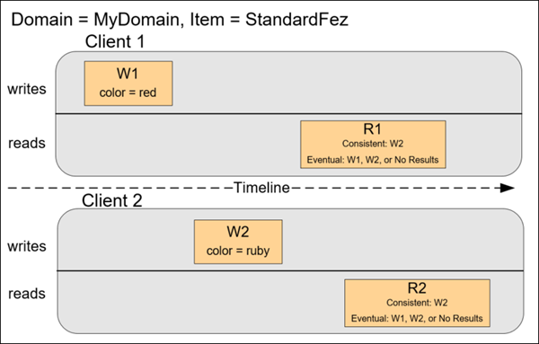

Concurrent Applications

Slide 9
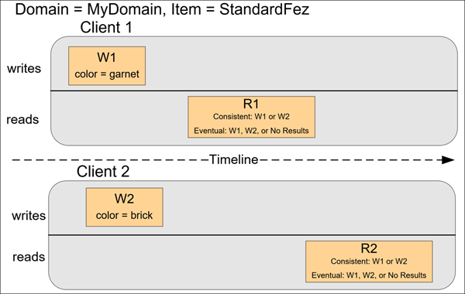

Slide 10
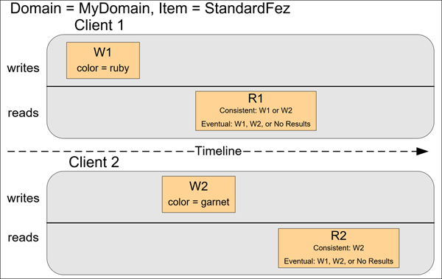

Slide 11

Simple Storage Service
Amazon Simple Storage Service (Amazon S3) is storage for the Internet. You can use Amazon S3 to store and retrieve any amount of data at any time, from anywhere on the web. You can accomplish these tasks using the AWS Management Console, which is a simple and intuitive web interface. This guide introduces you to Amazon S3 and how to use the AWS Management Console to complete the tasks shown in the following figure.

Slide 12
When do we need EBS?
In an event that EC2 machine looses its root volume (main drive) when it is manually terminated or sometimes unexpected terminations might happen then you need a way to store your Instance data somewhere.
When using Relational and NoSQL Databases. Databases such as SAP Hana, Oracle, Cassandra, MongoDB are widely deployed on EBS
For big data analytics engines such as Hadoop and Spark
Notes:
1st point hence comes Amazon EBS
2nd Point Casandra, MongoDB, CouchDB for NoSQL and rest of them for relational. MS SQL and PostgreSQL and MySQL also in relational
3rd point Amazon EBS offers data persistence, dynamic performance adjustments, and the ability to detach and reattach volumes, allowing you to resize clusters
4th Amazon EBS lets you scale easily with additional volumes to support growing file systems, and the choice of four different volumes to optimize price and performance.
5th Minimize data loss and recovery time with the ability to regularly back up your data and log files across different geographic regions. Quickly restore new volumes to launch applications in new regions.

Slide 13
What is EBS?
An EBS (Elastic Block Store) Volume is a network drive you can attach to your instances while they run
Allows your instances to persist data
Not a physical drive, which means there might be a bit of latency
Can be detached from an EC2 instance and attached to another one quickly
Locked to an Availability Zone (AZ)
An EBS Volume in us-east-1a cannot be attached to us-east-1b
Have provisioned capacity (size in GBs, and IOPS)
You get billed for all the provisioned capacity
You can increase the capacity of the drive over time

Slide 14
Advantages of EBS
Easy to use
Highly available and durable
Performance for any workload
Virtually unlimited scale
Secure
Cost-effective

Slide 15
EBS Volume Types
EBS Volumes come in 4 types:
GP2 (SSD): General purpose SSD volume that balances price and performance for a wide variety of workloads
IO1 (SSD): Highest-performance SSD volume for mission-critical low-latency or high- throughput workloads
ST1 (HDD): Low cost HDD volume designed for frequently accessed, throughput- intensive workloads
SC1 (HDD): Lowest cost HDD volume designed for less frequently accessed workloads
EBS Volumes are characterized in Size | Throughput | IOPS
Notes:
As of Feb 2017, you can resize the EBS volumes
You can only increase the EBS volumes:
Size (any volume type)
IOPS (only in IO1)
After resizing an EBS volume, you need to repartition your drive
To size down, you need to use EBS Snapshots

Slide 16
EBS Snapshots
EBS Volumes can be backed up using “snapshots”
Snapshots only take the actual space of the blocks on the volume
If you snapshot a 100GB drive that only has 5 GB of data, then your EBS snapshot will only be 5GB
Snapshots are used for:
Backups: ensuring you can save your data in case of a catastrophe
Volume migration:
Resizing a volume down
Changing the volume type
Encrypt a volume

Slide 17
EBS vs Instance Store
Pros:
Better I/O performance
Cons:
On termination, the instance store is lost
You can’t resize the instance store
Backups must be operated by the user
Overall, EBS-backed instances should fit most applications workloads
Notes:
Some instance do not come with Root EBS volumes Instead, they come with “Instance Store”. Instance store is physically attached to the machine

Slide 18
Recap of S3 and EBS
Notes:
EBS can be attached to only one instance at a time
EBS are locked at the AZ level
Migrating an EBS volume across AZ means first backing it up (snapshot), then recreating it in the other AZ
EBS backups use IO and you shouldn’t run them while your application is handling a lot of traffic
Root EBS Volumes of instances get terminated by default if the EC2 instance gets terminated. (you can disable this)

Slide 19
Demo

Slide 20
Questions??

